Slide 1
Visual Effects in Advertisements
54 - Bhakti Shah

Slide 2
10 Commonly Used Techniques in Visual Advertising

Slide 3

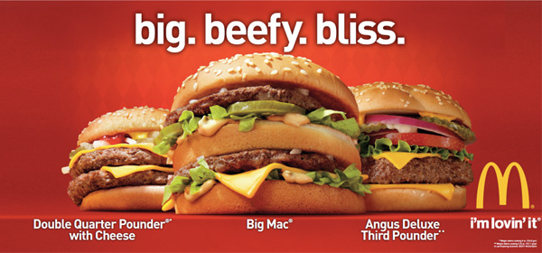

Slide 4

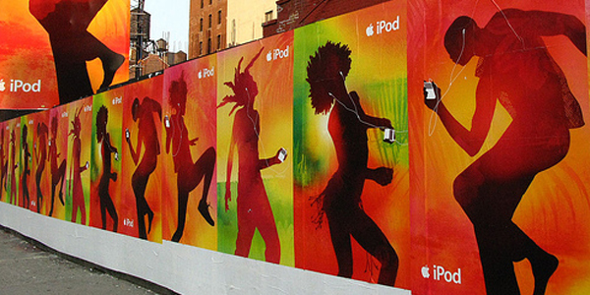

Slide 5

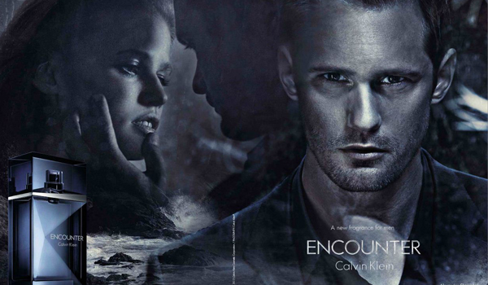

Slide 6



Slide 7

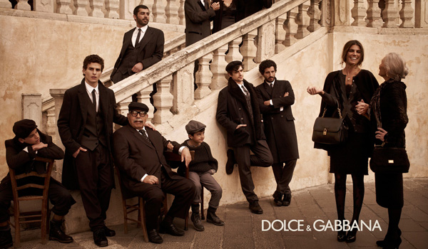

Slide 8



Slide 9



Slide 10

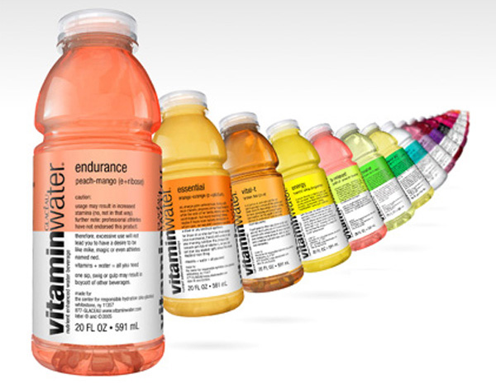

Slide 11

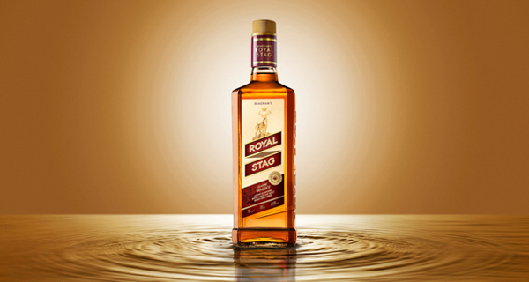

Slide 12



Slide 13
Visual effects can be divided into two
catagories:
Photographic (made with a camera)
or
Digital (made with a computer).

Slide 14
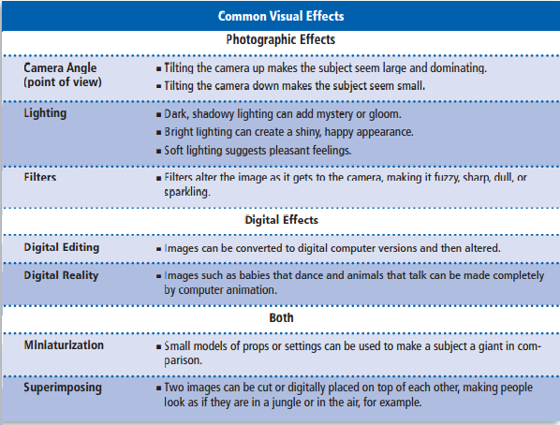

Slide 15
Use of Animation and VFX in various advertisements

Slide 16
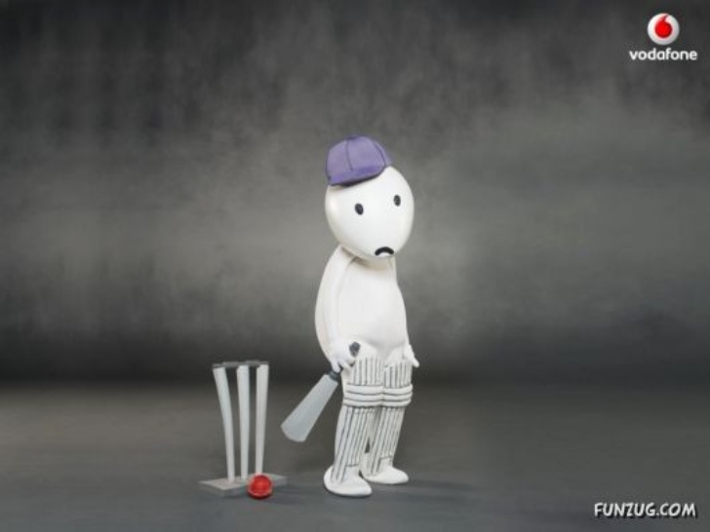
Vodafone ZooZoo
The Vodafone ads featuring the Zoo Zoo cartoonshape become the hot talk during the current IPL broadcasts
Prakash Varma, ad filmmaker, Nirvana Films, has directed the commercials, and reveals that the Zoozoos were a big challenge to create.
It is said that Vodafone has spent 30 crorerupees for making 30 ads with these cartoons.

Slide 17
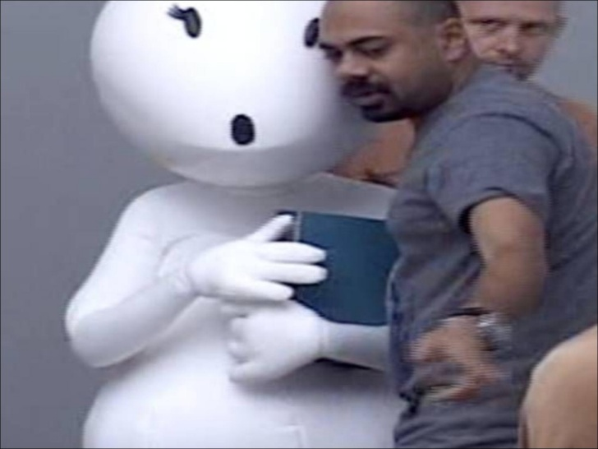
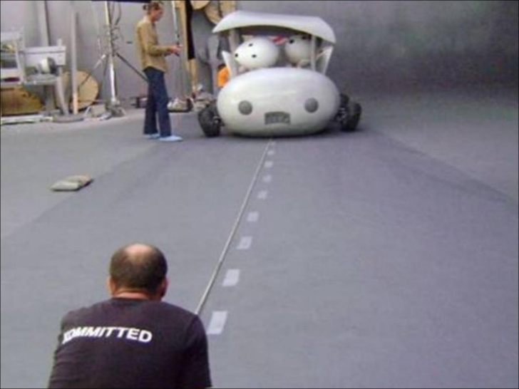
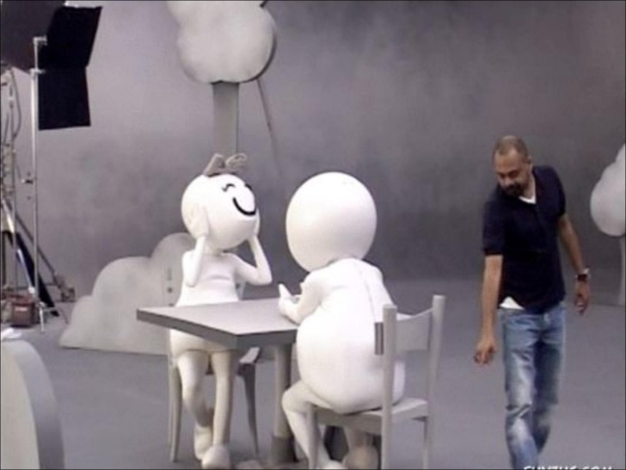
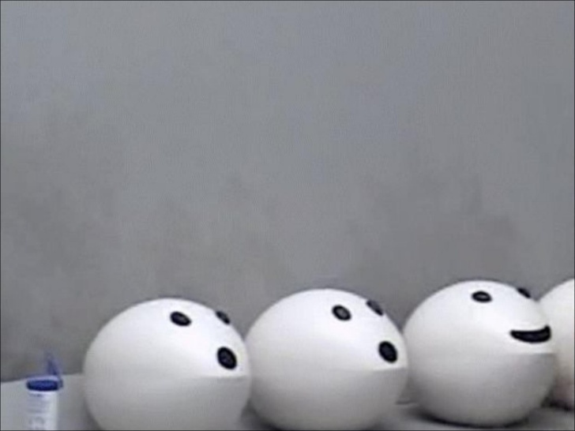

Slide 18
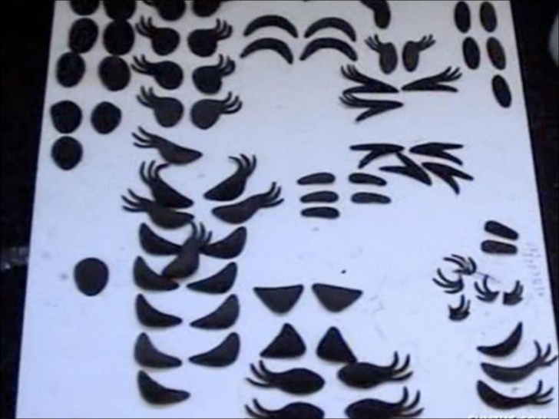
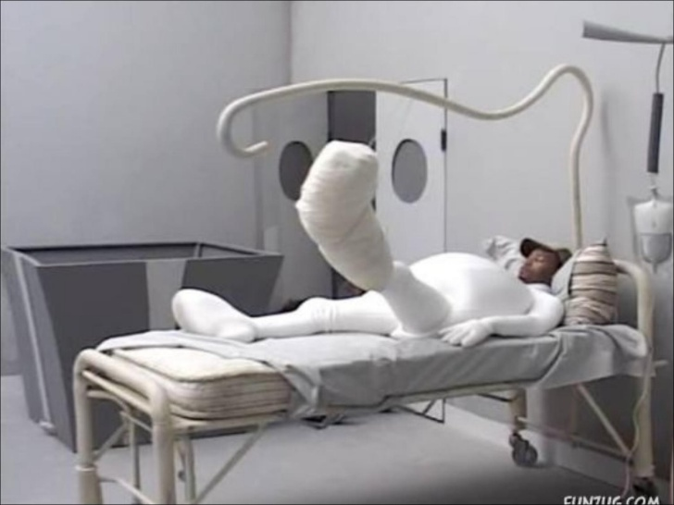
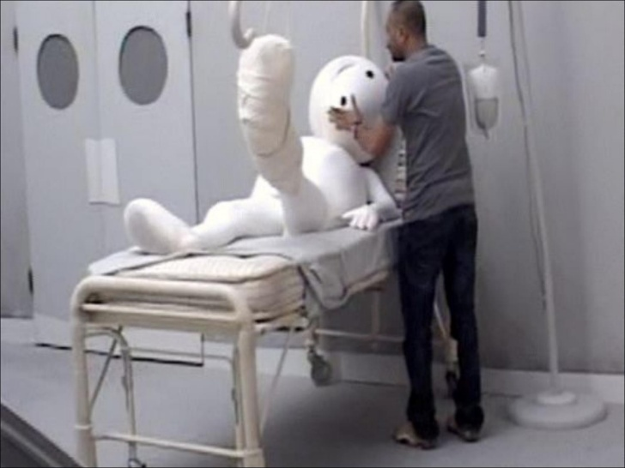

Slide 19
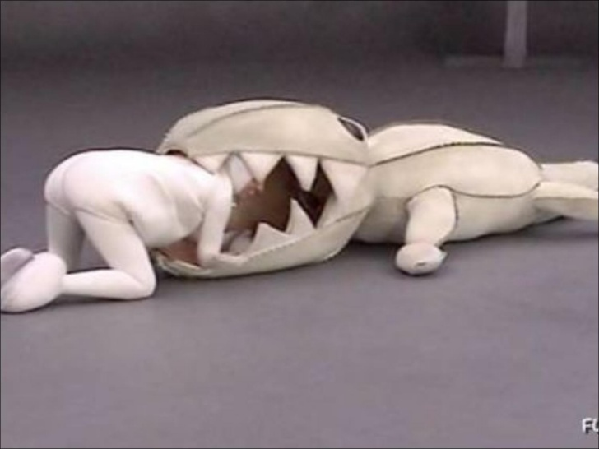
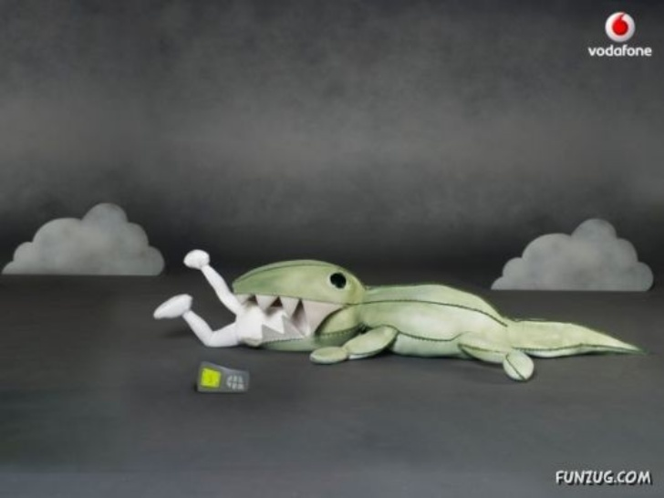

Slide 20
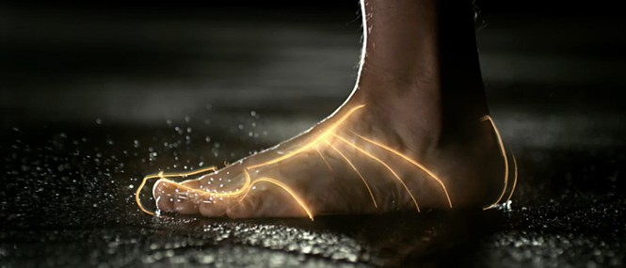
Nike Biomorph Camaign
This commercial Nike “Biomorph” bagged Visual Effects Society Award in 2013.
The commercial spotlighted how the new technology makes the shoe a seamless wear. For the ad, Digital Domain created an anatomical view of human foot and the shoe.

Slide 21
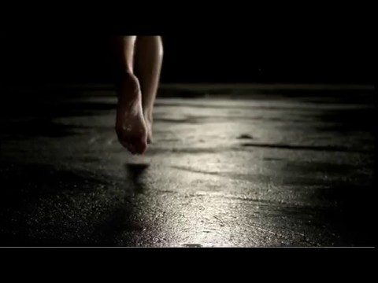

Slide 22
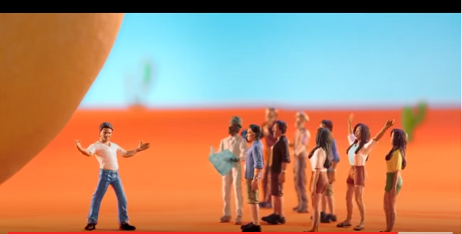
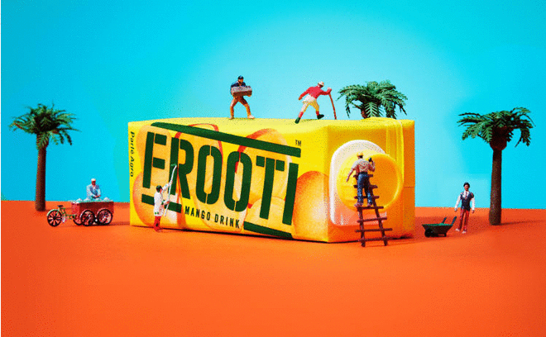
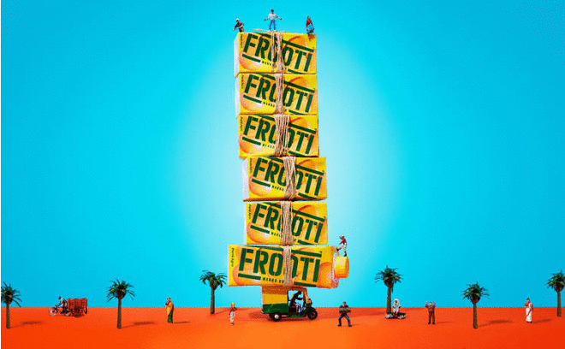
Frooti Campaign

Slide 23
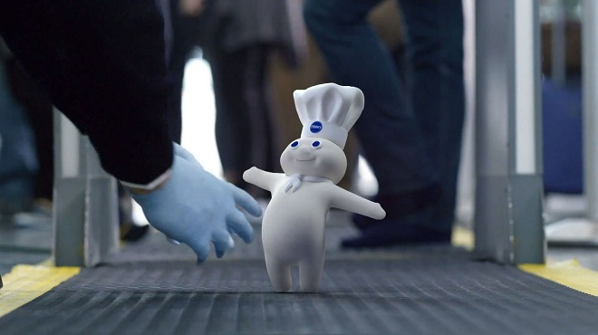
Pillsbury Dough
Many of us associate Pillsbury with its mascot “Poppin’ Fresh” who’s a cute chef made up of dough with blue eyes and a scarf tied around his neck.
The mascot is commonly known as Pillsbury Dough and was created by Rudy Perz back in 1965 using a blend of stop-motion clay animation technique.

Slide 24
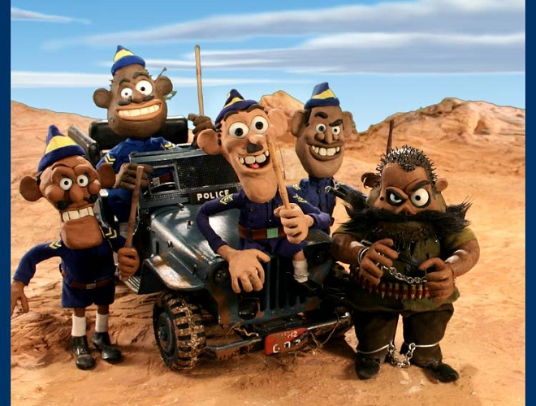
Amaron : In the famous Amaron ads, claymotion technique was used for the very first time in Indian advertising market.
This innovative ad was produced by E Suresh in 2002 and had bagged many awards along the way..

Slide 25
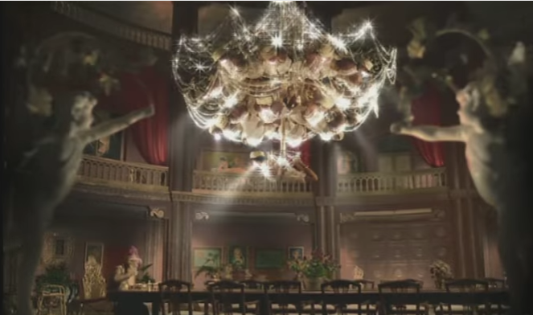

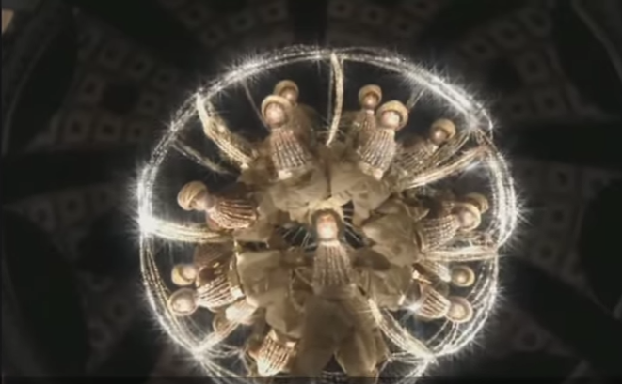

Slide 26
This commercial was a brilliant combination of VFX and animation. The Happydent ad campaign worked on the concept ‘chewing gum for sparkling teeth’.
This concept was delivered through a fictional setting where men, instead of bulbs, provide light by eating Happydent gum and smiling.
It was shot using real artist but the light effects and most of the set creation was done in post production.
Animation saved the day when software were used to create the landscape as well as VFX was used to show proper ambience, light and sound effects.

Slide 27
Bibliography
http://srushtivfx.com/how-vfx-grabs-a-viewers-attention-and-why-it-is-so-important-in-advertising/
http://www.animationxpress.com/index.php/latest-news/popular-brand-campaigns
http://blog.visme.co/visual-advertising-techniques/
http://www.maacindia.com/blog/index.php/top-advertising-campaigns-that-used-animation-vfx-in-india/
https://www.slideshare.net/shahsd1920/vodafone-zoo-zoos
https://www.fxguide.com/quicktakes/ves-commercials-nike-biomorph/

Slide 28


